Slide 1
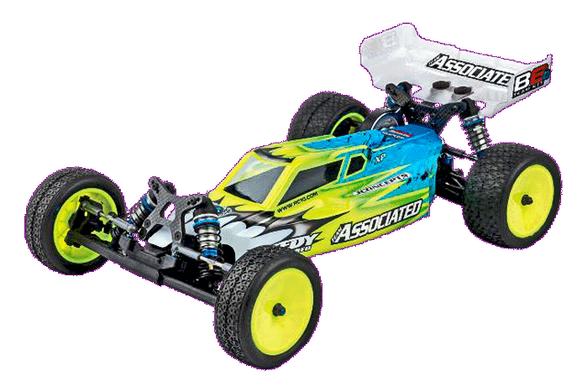
Parking Aid System for RC cars

Slide 2
Table of contents
Idea
Real-World application
Our Realization
Hardware Used
Components Used
Schematics
State chart
Demo
Hardware
Android
Q&A

Slide 3
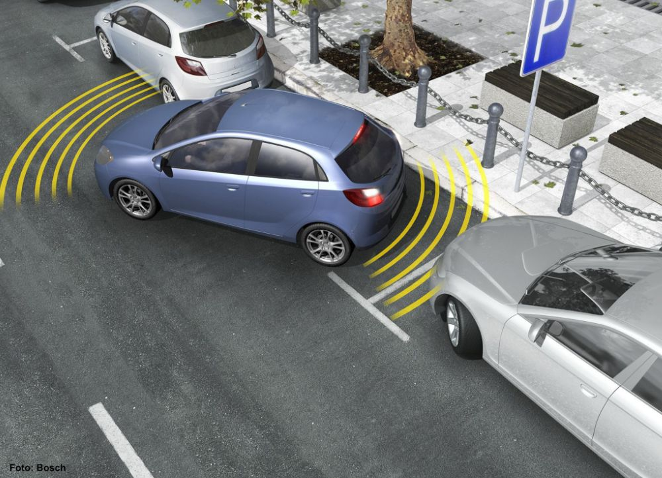
Idea
Parking Aid Systems
&
Our Implemenation

Slide 4
Parking Aid Systems
Designed to make parking easier
20 to 250 cm in front and behind the vehicle
Warn the driver about obstacles
Normally activated when engaging the reverse gear
Or when the vehicle drops below a defined speed
Using Ultrasonic sensors
Basic variants 3 to 4 sensors
Elaborate versions use up to 12 sensors
Acoustic of visual signal

Slide 5
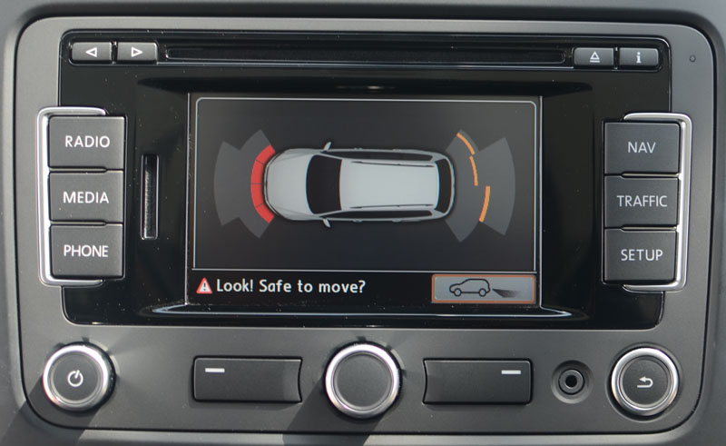
Parking Aid Systems
Parking aid systems basically consist of the following components:
Ultrasonic sensors
Control unit
Warning element

Slide 6
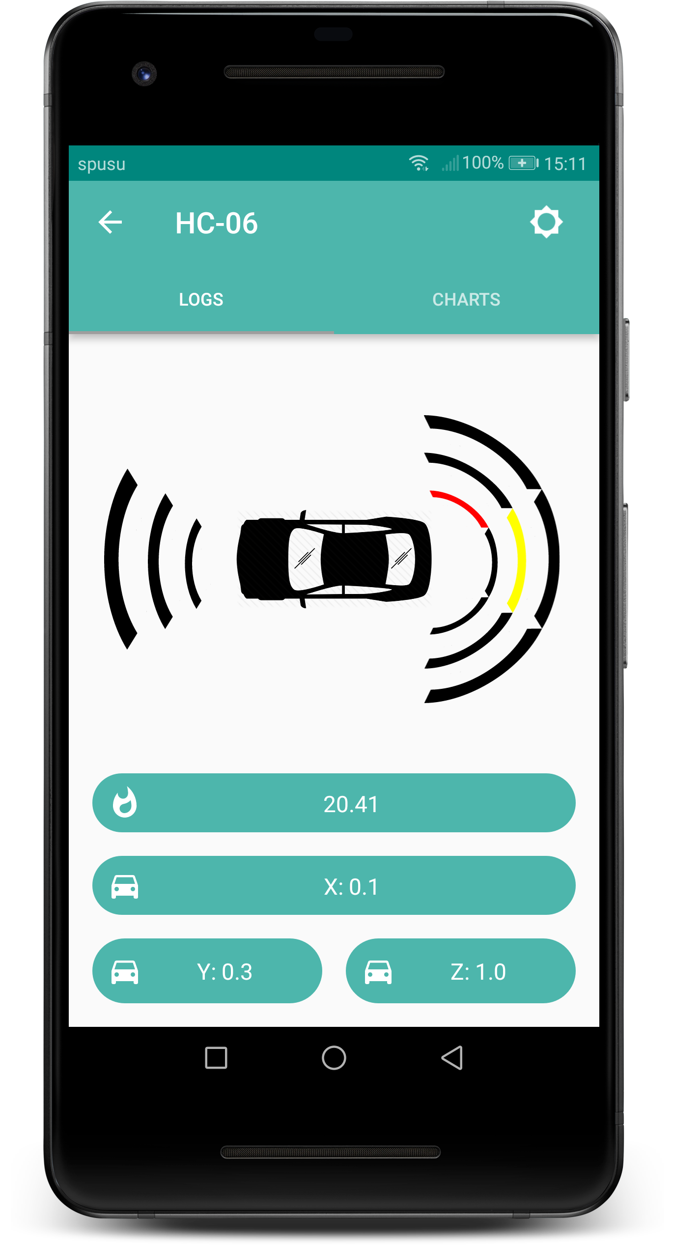
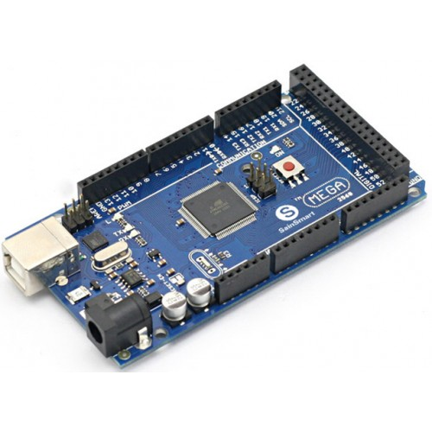
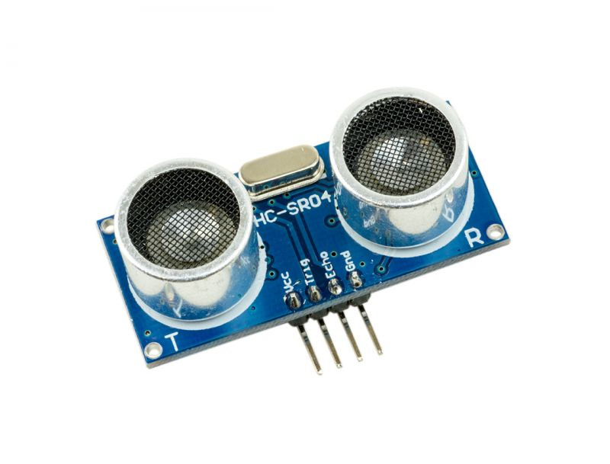
Our Implementation
Our implementation also consist of the following components:
Ultrasonic sensors
Control unit
Warning element

Slide 7
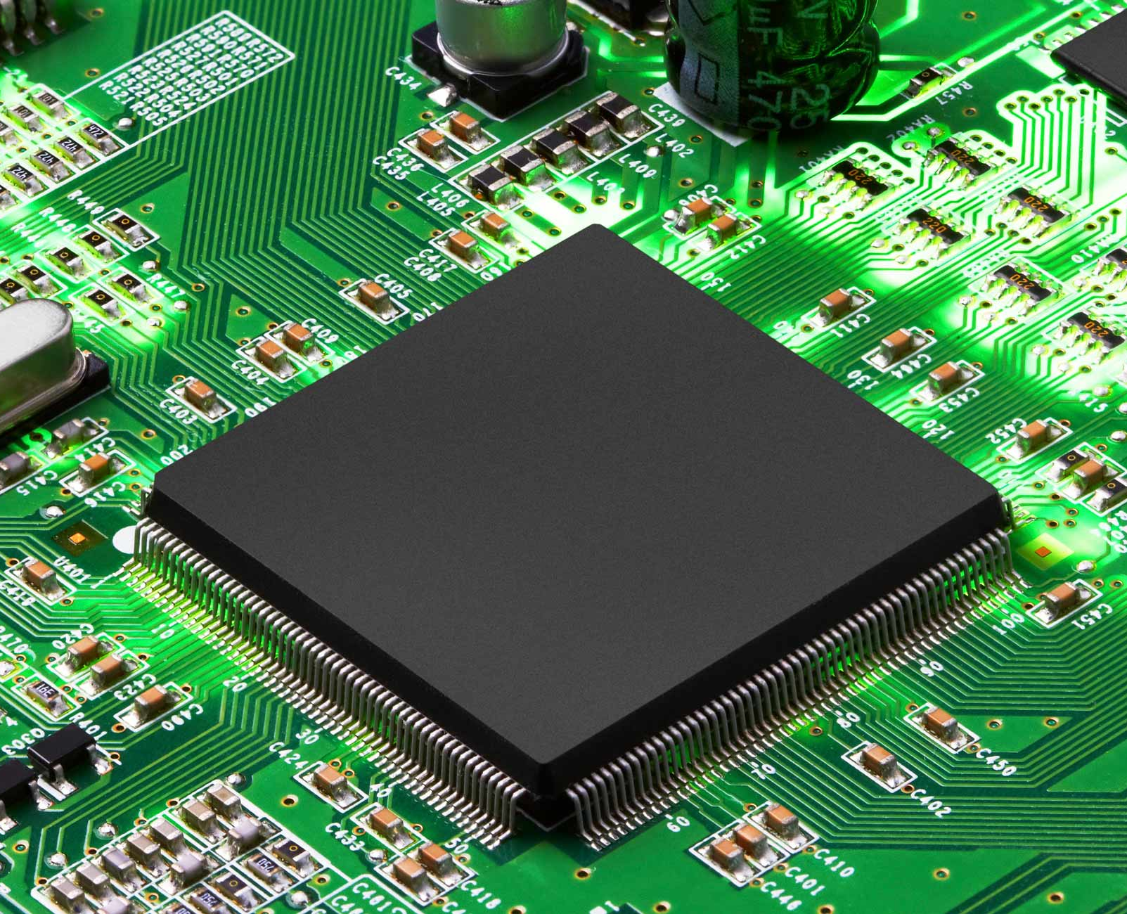
Hardware Used
Schematics
&
Flow chart

Slide 8
Hardware Used
SainSmart Mega comparable with Arduino Mega
Ultrasonic sensors x 4 (HC-SR04)
NTC used as Temperature sensor
Light Dependent Desistor (LDR)
Accelerometer
Piezo for acoustic signalization
Bluetooth Modul (HC-06)
Ultra bright white Leds to simulate the Lights
Red Leds to simulate an emergency brake

Slide 9
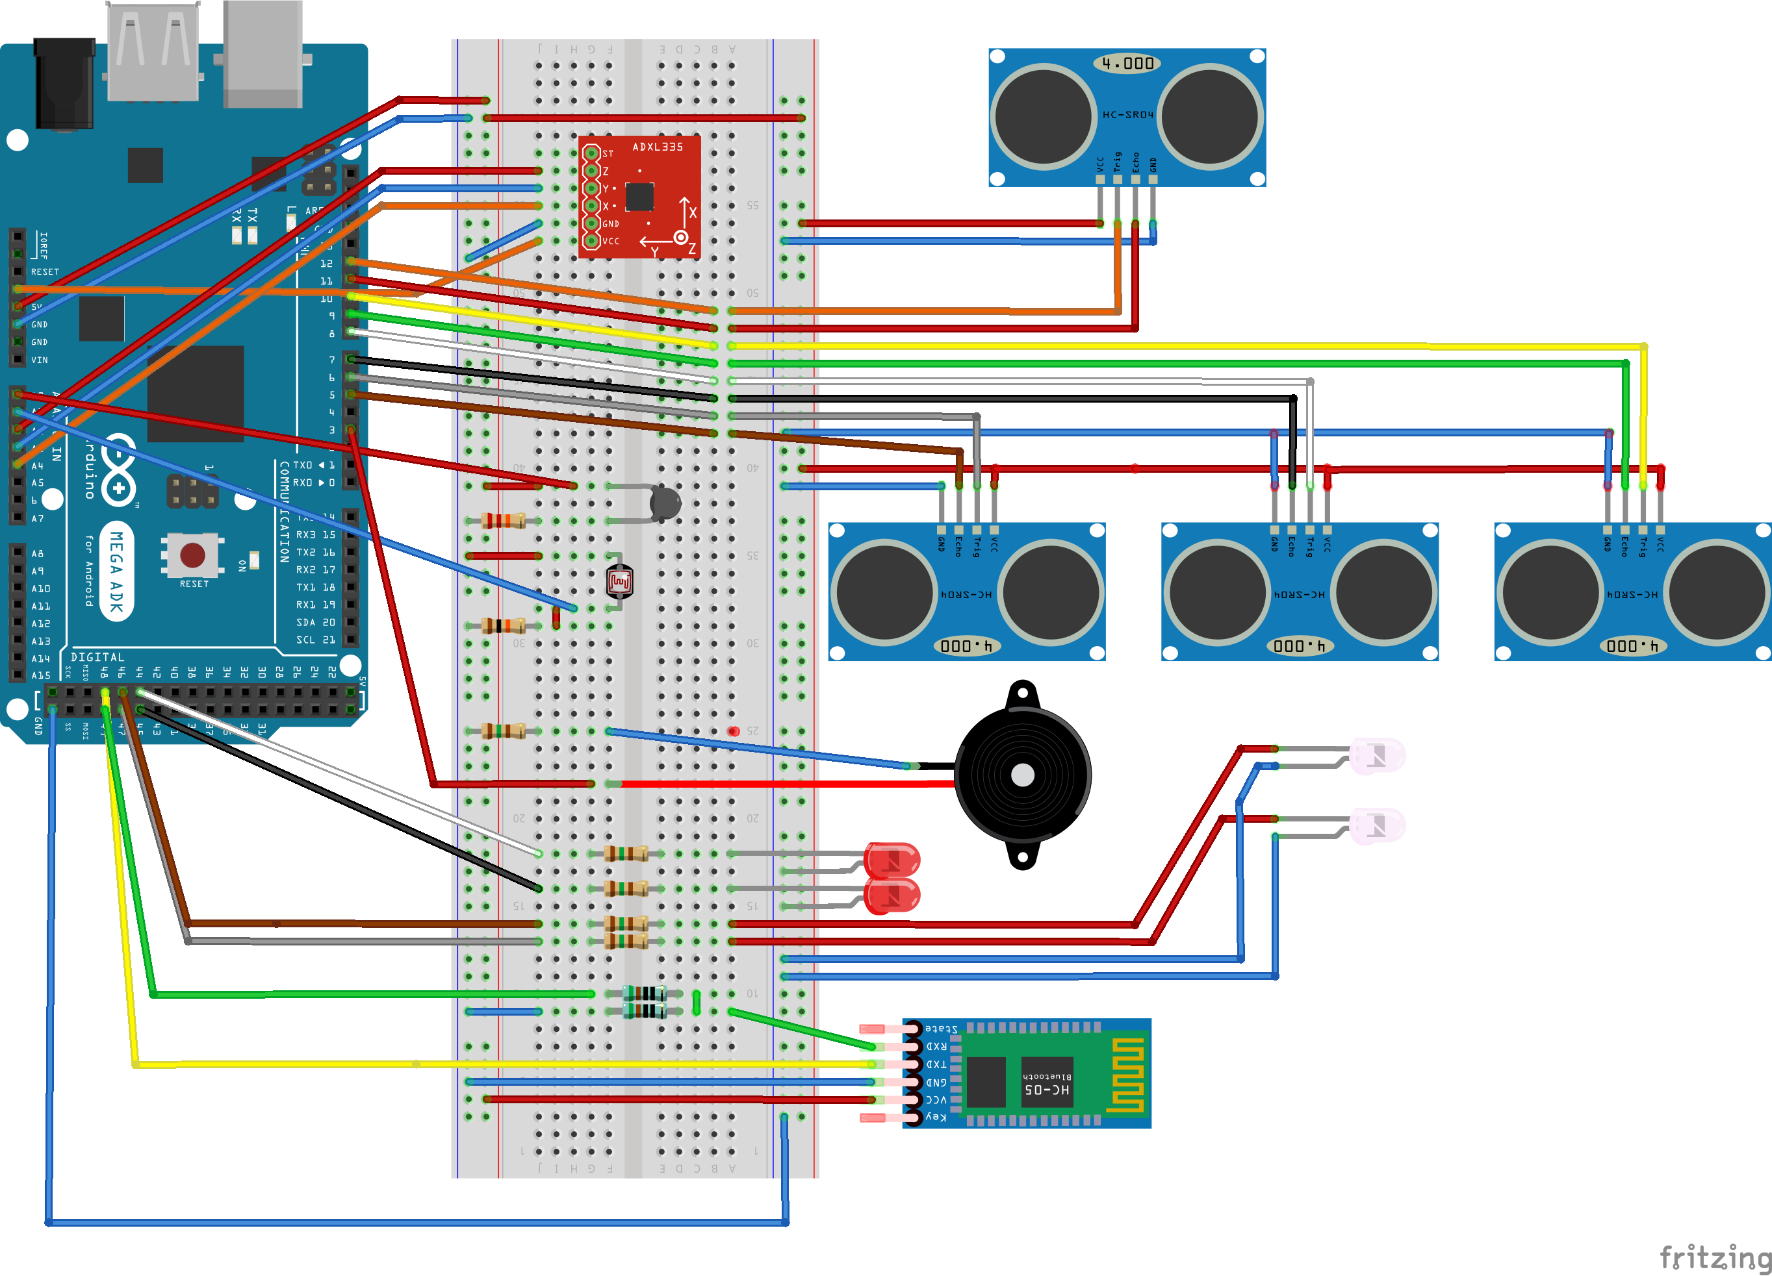
Schematics

Slide 10
Flow Chart

Slide 11
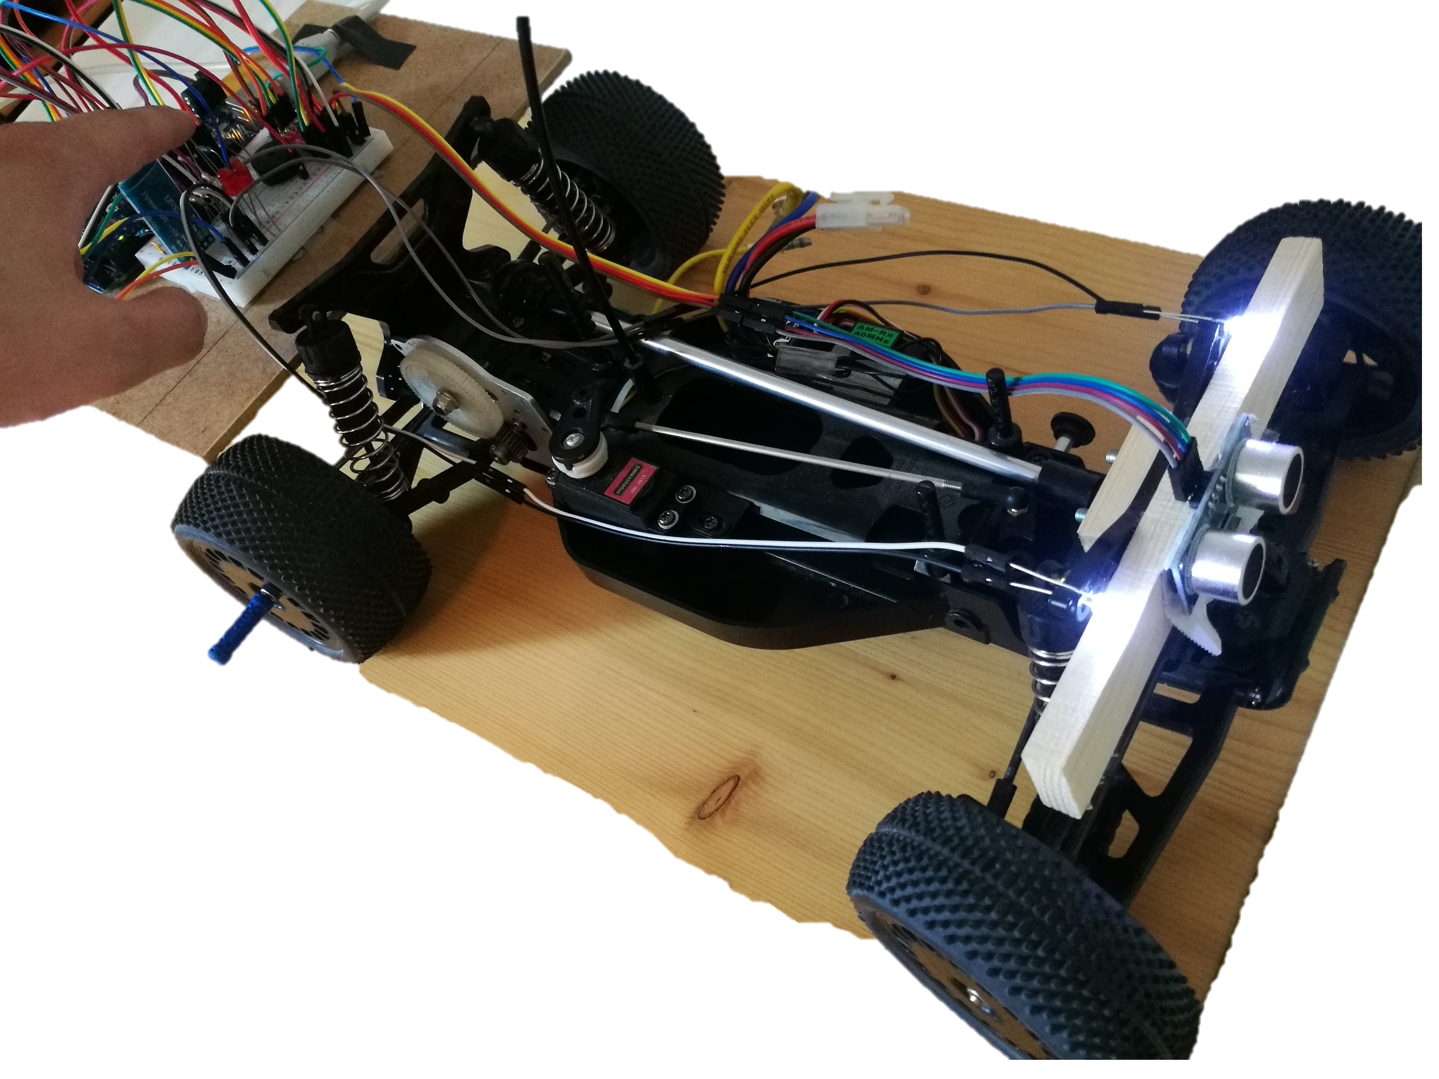
RC Car

Slide 12
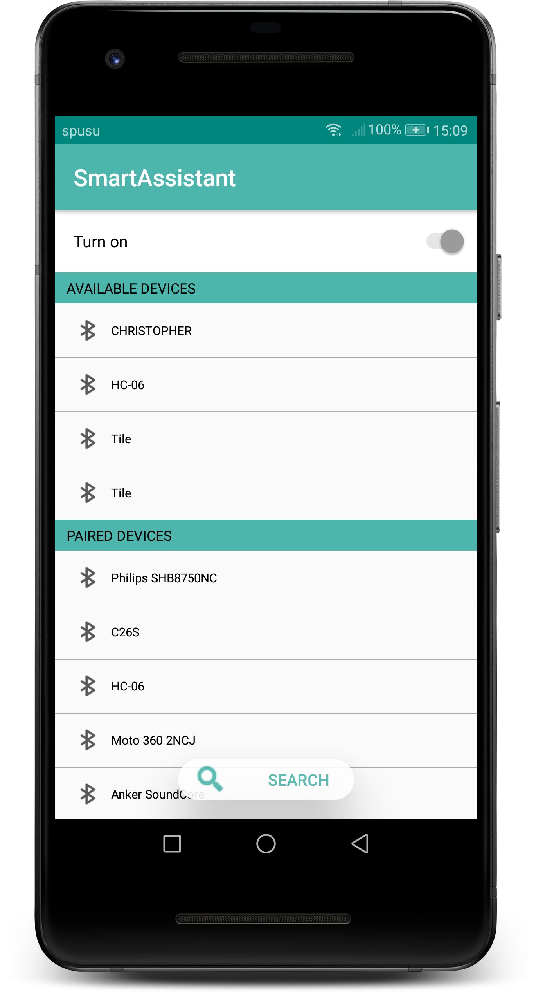
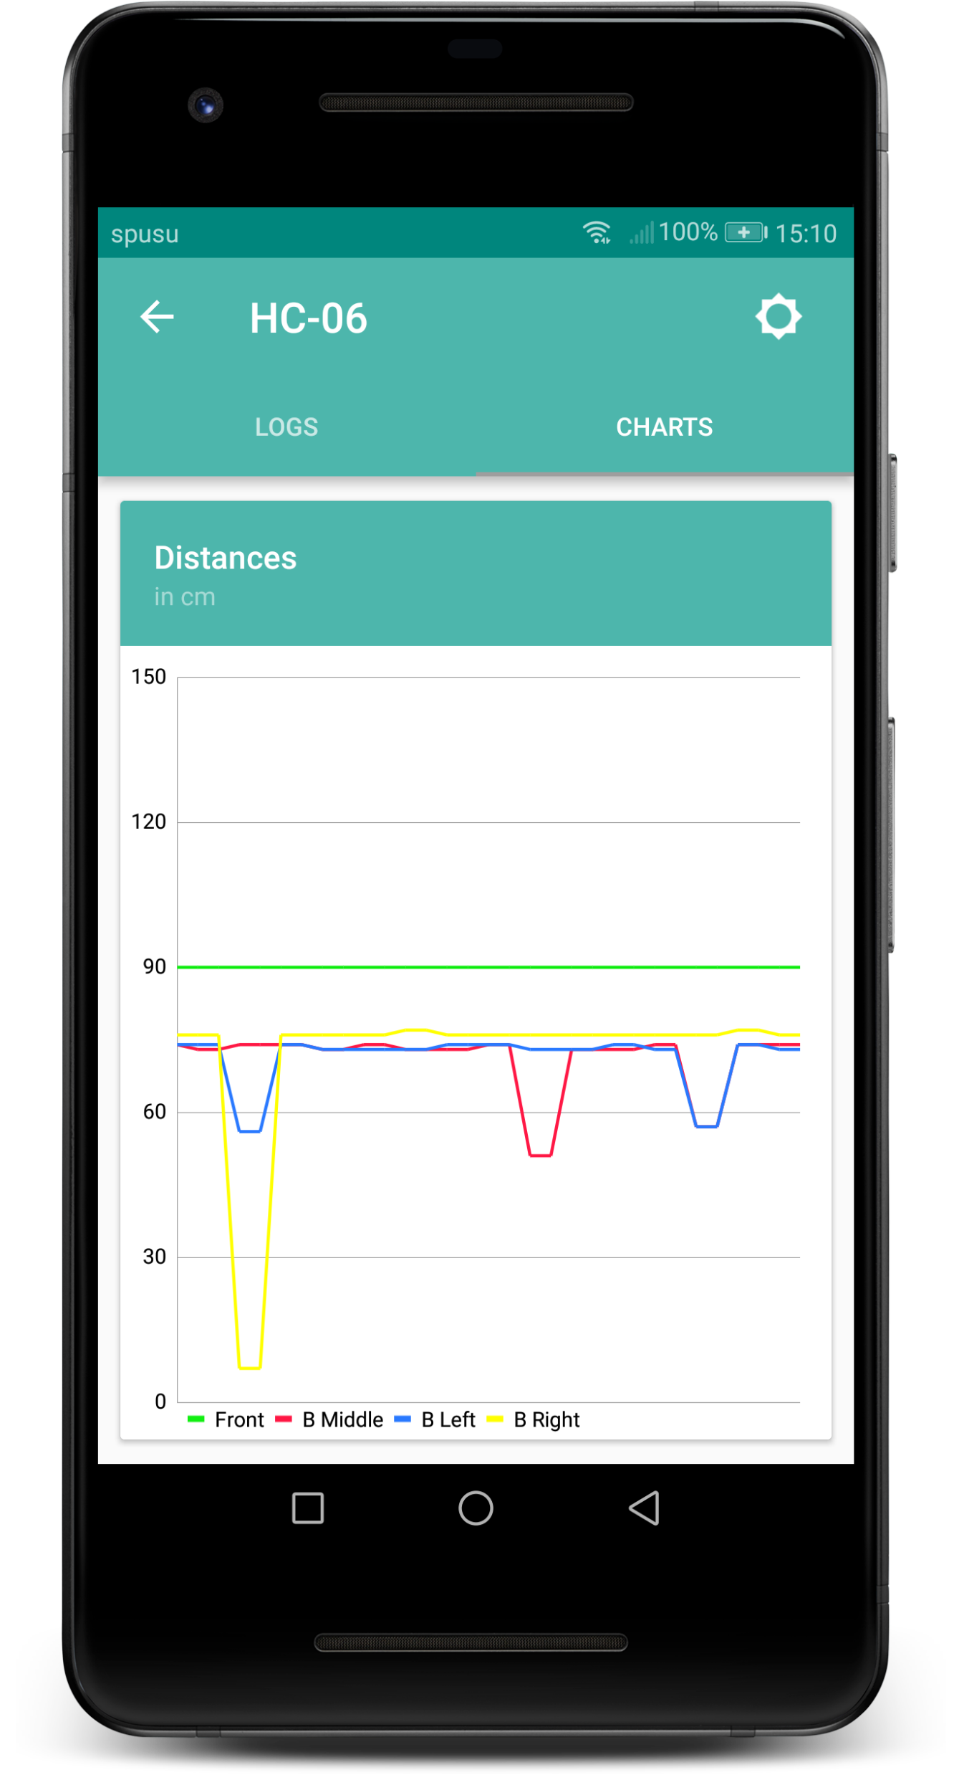
Android Application

Slide 13

Demo
Hardware
&
Android

Slide 14

Q & A

